Slide 1


Loan Prediction System Based on Machine Learning
Presenter
Asfand Ali
Mahesh Yadav Udutha
1

Slide 2


Group Member
Asfand Ali
Mahesh Yadav Udutha
Matricola Id 2068882
Matricola Id 2056251
2

Slide 3

AGENDA
Introduction
Literature Review
Problem Statement & Problem Solution
Software Used
Aim and objective of the Research
Proposed Work
Machine Learning Prediction Model
Logistic Regression
Decision Tree Classifier
UI Interface
Result and Working
Advantages
Application
Conclusion & Discussion
References
3

Slide 4
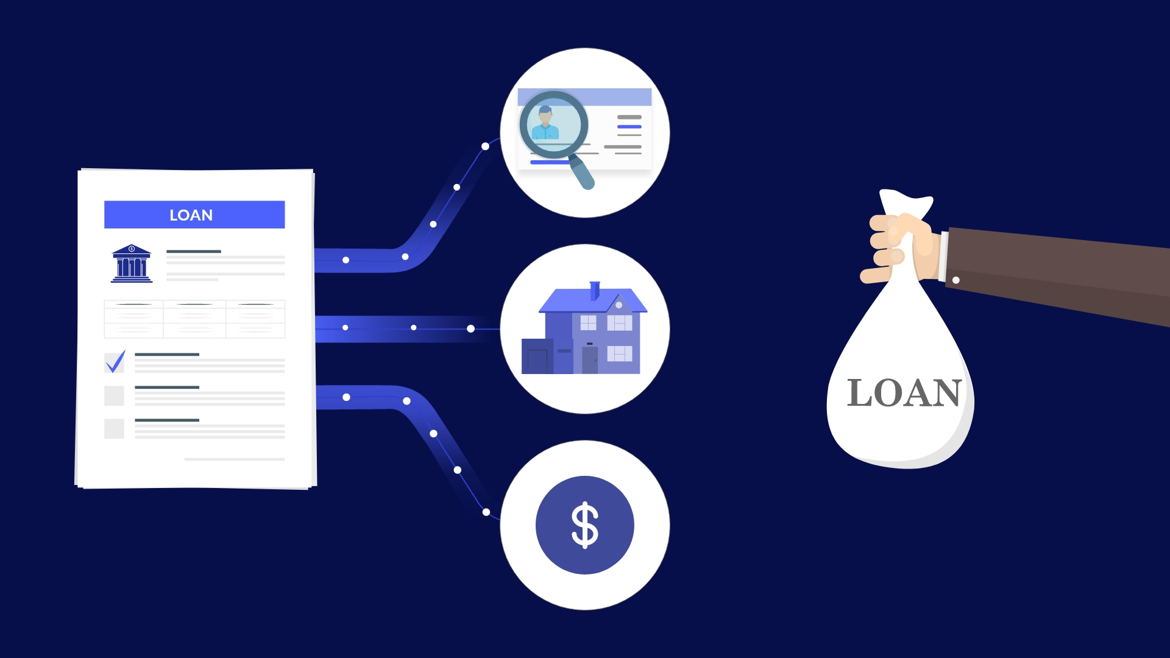
INTRODUCATION
Loans are the core business of banks and main profit comes directly from the loan’s interest. The loan Companies grant a loan after an intensive process of verification and validation however they still don’t have assurance if the applicant can repay the loan with no difficulties. In our lab project we built a predictive model to predict if an applicant is eligible for the loan or not. We prepared a model to predict the target variable and made a User Interface / web application.
4

Slide 5
LITERATURE REVIEW
We have described a system designed particularly for bank employee to categorize the loan application based on priority. We have shown the output in the form of accepted or rejected based on the different parameters enters in the given form such as loan history, gender, income, etc. for loan application
We have taken the customer data from the kaggle which has approved their loan request. We have used logistic regression, Decision tree algorithm of machine learning technology and focused on the pre- processing steps required to be performed after getting the database for the better model development. We have described about the prediction of modernized loan approval system based on machine learning approach to know the status whether the loan will approved or rejected. Logistric Regression and decision tree to classify the data into the appropriate classes and has found the good accuracy.
We have developed an automated system using decision tree algorithm to solve the existing system problem
5

Slide 6

PROBLEM STATEMENT & PROBLEM SOLUTION
Problem Statement
Human errors can be introduced during the validation process.
No Cross referencing previous loan records
Lot of human resources required
Problem Solution
Our Machine learning model calculates all the parameters given and predicts if the applicant is eligible for loan or not in very less time
Time required for verification and validation.
6

Slide 7
SOFTWARE USED
Languages used
HTML
CSS
Python Flask
Software Code Editor Used
Vs Code
7

Slide 8
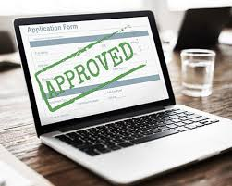

AIM & OBJECTIVE OF THE RESEARCH
To make the process of loan approval easy using fewer resources and human resources
To make the web-app which can be accessible by anyone on the internet without downloading any desktop software
To make the prediction model which will make the accurate predictions and helps banks to make approving loans very easy.
Lab Project Loan Prediction System Based on Machine Learning
8

Slide 9
PROPOSED WORK
Data Collection - Two CSV files: Train, Test are used for this project
Analyzing data: Analyzing data what kind of data we are using
Data Cleaning – Clean the Data for any null values if present.
Model Building - After analyzing and cleaning the data we can build ML model
Exporting the model and building the User interface / Web app using flask web server
9

Slide 10
MACHINE LEARNING PREDICTION MODEL
Logistic Regression
Logistic Regression is called Logistic model. It takes independent features and return outputs.
It is used to calculate or predict the probability of a binary (yes/no) event occurring. An example of logistic regression could be applying machine learning to determine if a person is likely to be infected with loan or not.
10

Slide 11
MACHINE LEARNING PREDICTION MODEL
Decision Tree Classifier
Decision Tree Classifier is a flexible easy to use machine learning algorithm that produces good result.
It’s is used when bank doesn’t know about customer
Income we have implemented the decision tree to predict customer income based on occupation
Product and various different variables.
It is also one of the most used algorithm because of its simplicity and diversity
We got accuracy from Decision Tree is 77.272%.
11

Slide 12
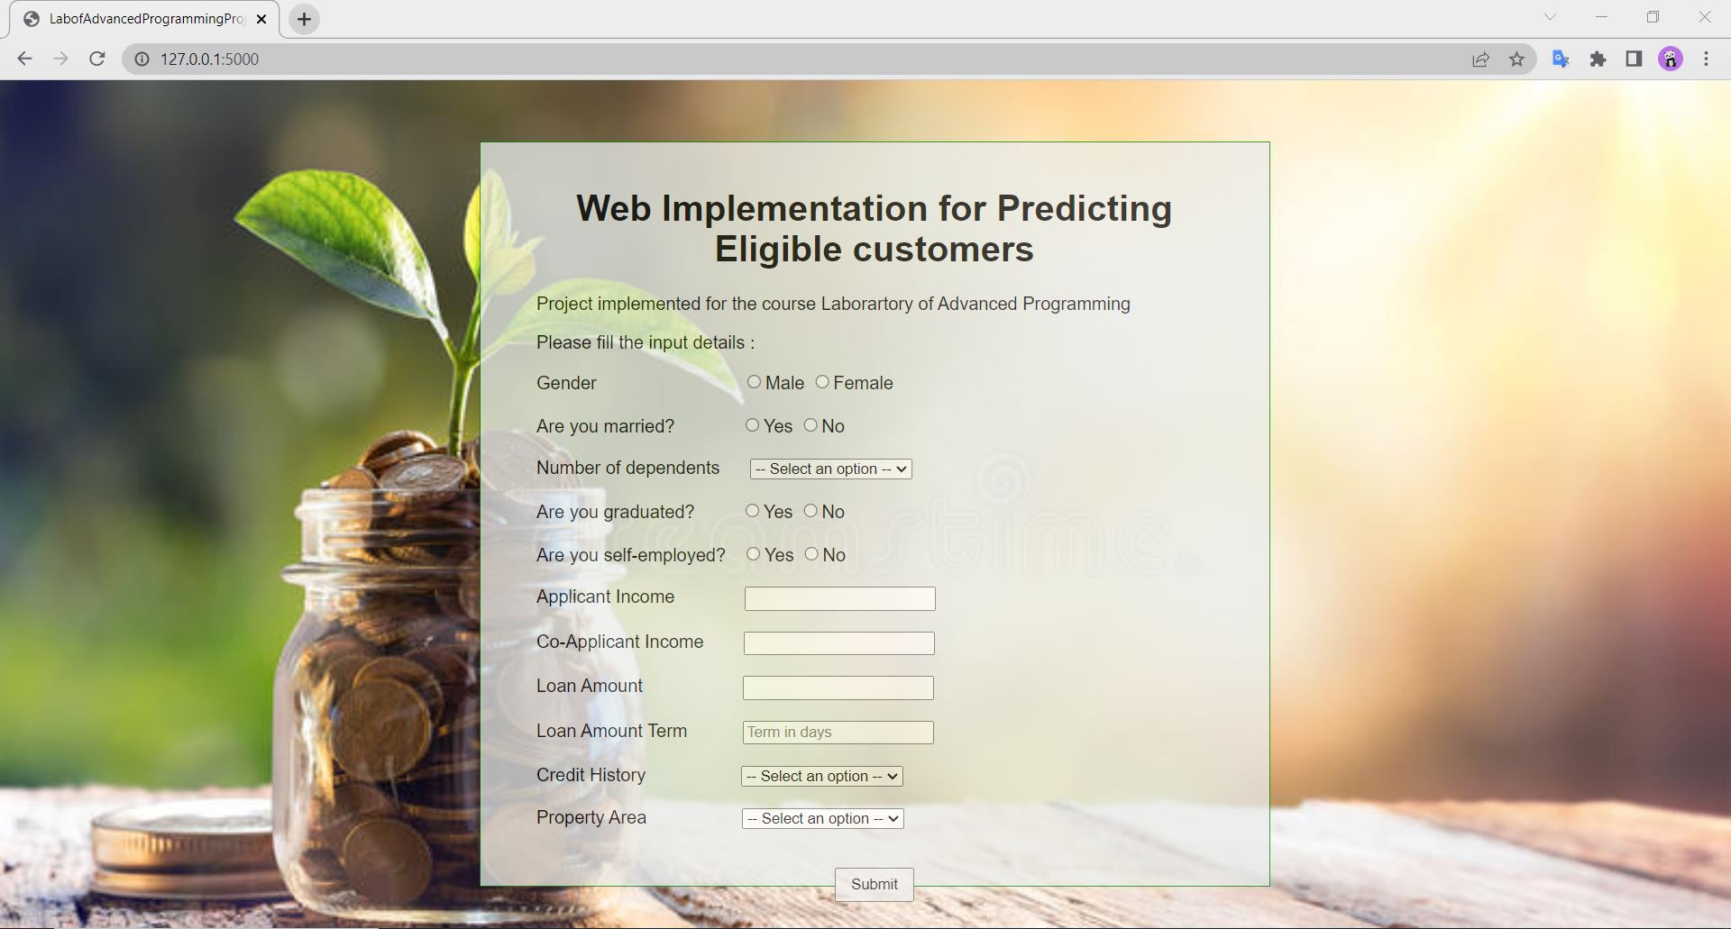
USER INTERFACE ( UI )
Fig. Web-app on Desktop Screen
12

Slide 13
RESULTS & WORKING
Step 1
Open the web-app and navigate to the prediction from page where we fill our data.
Fig. Web-app Home page
13

Slide 14
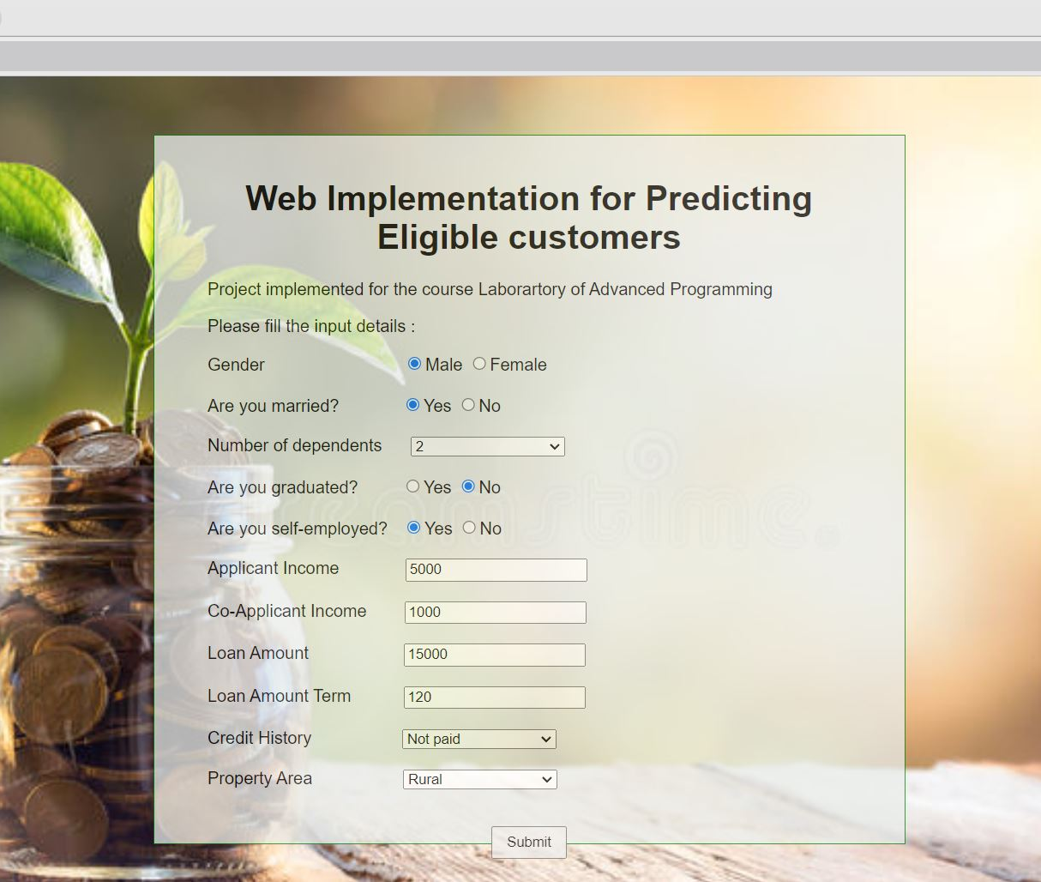
WORKING
Step 2
Fill all the data in the given form and press predict button to get prediction.
All the data will be sent backend script and then the prediction model for processing.
Fig Web-app Prediction form Page
14

Slide 15
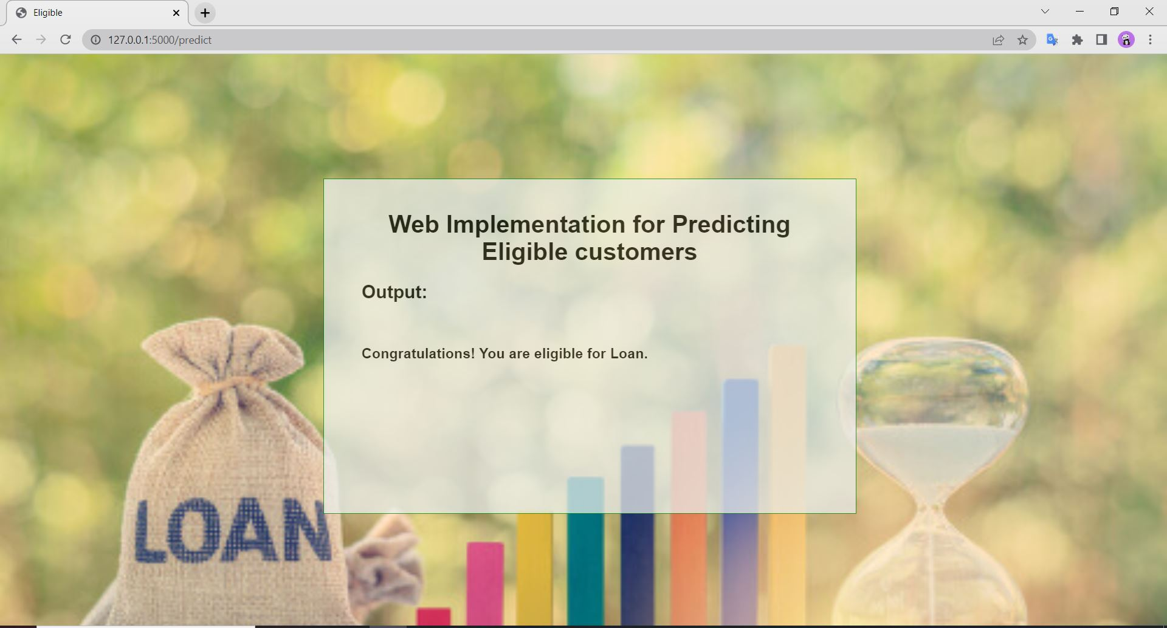
WORKING
Step 3
View the predicted result
15

Slide 16
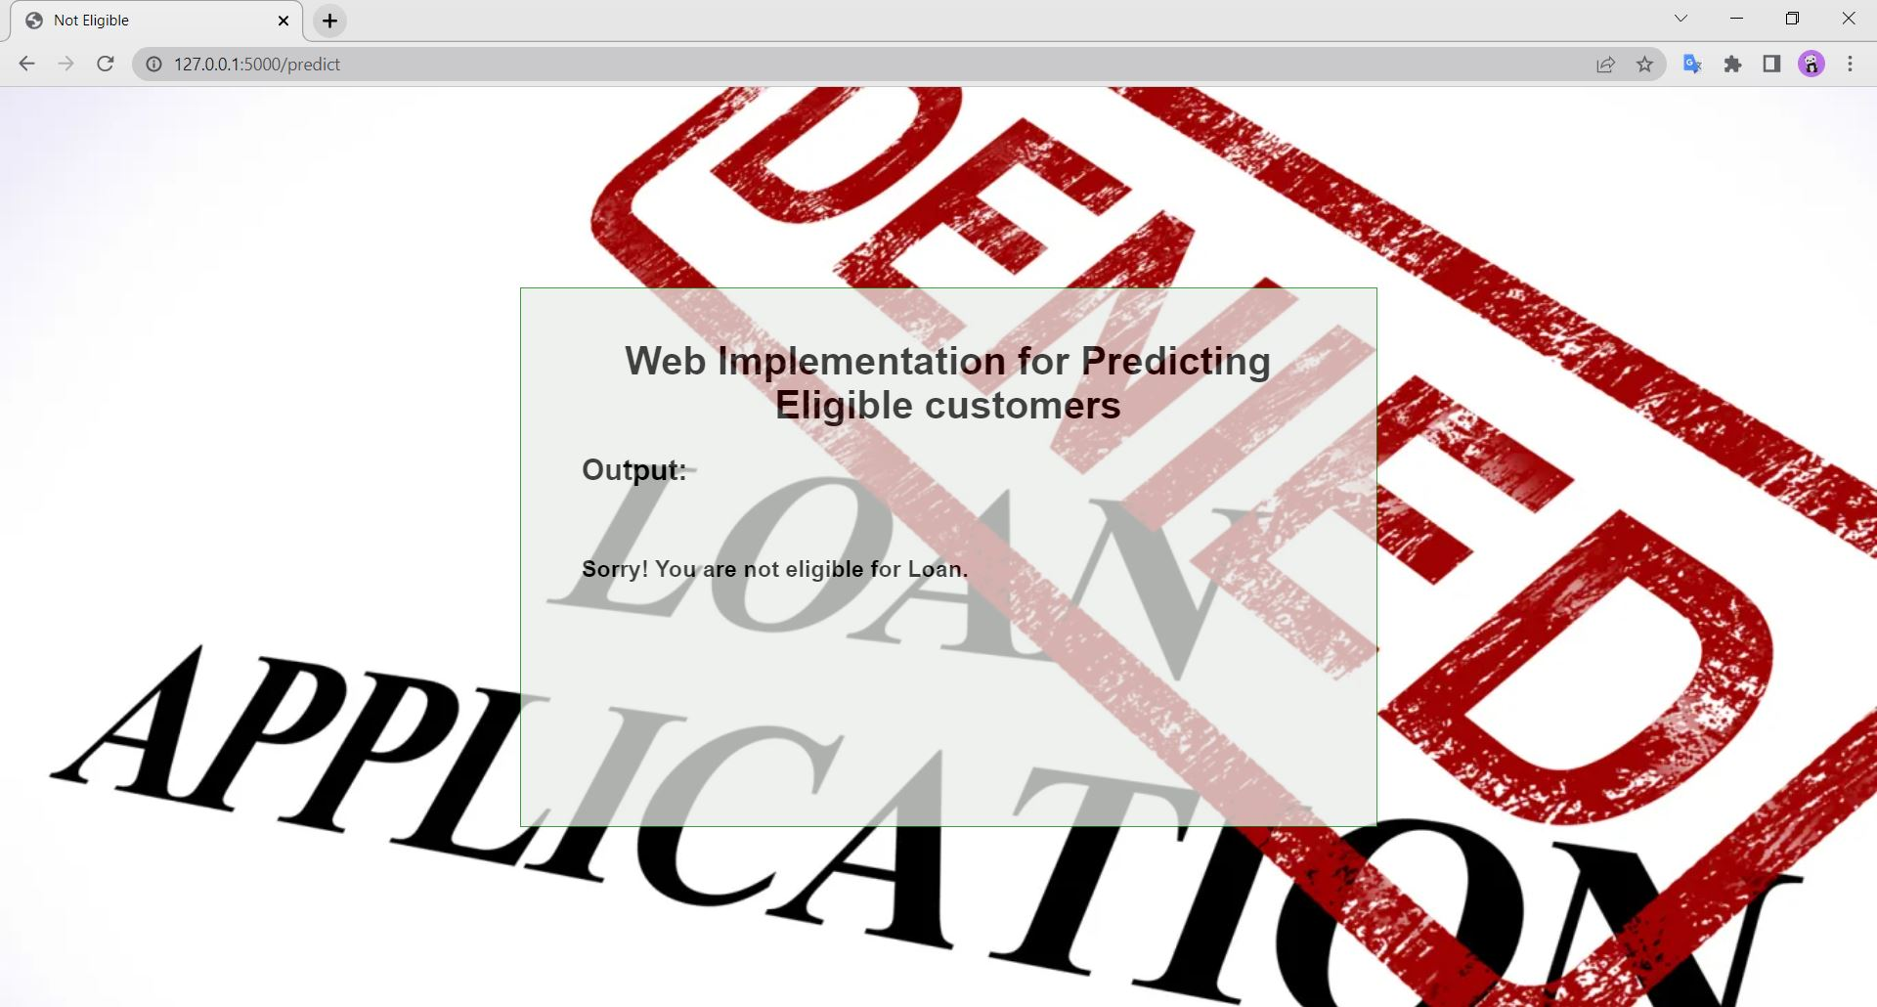
Step 3 View the predicted result
WORKING

Slide 17
ADVANTAGES
There have been number of cases of input glitches. Human error in content while filling it manually automated prediction system is more reliable
The complexity filing loan in bank will become much easier as an applicant will know how much amount of loan viable.
17

Slide 18
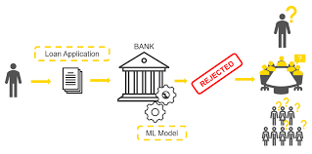

APPLICATIONS
In Banking Sector.
Co-operates sector which provides loan to their employees.
Individual Applicant who wants to know about his capability of taking loan.
18

Slide 19
CONCULSION & DISCUSSION
The system approved or rejects the loan application. Recovery of loan is a major contributing parameter in the financial statements of a bank. It is very difficult to predict the possibility of payment of loan by the customer. Machine learning are very useful in predicting outcomes for large amount of data.
In our lab project two machine learning algorithm Logistic Regression Decision Tree are applied to predict the loan approval of customer. The experimental result conclude that the accuracy of Decision Tree machine learning is better than compared to Logistic Regression and Decision Tree Machine Learning approaches.
19

Slide 20
REFERENCES
[1] Kumar Arun, Garg Ishan, and Kaur Sanmeet. Loan approval prediction based on machine learning approach. IOSR J. Comput. Eng, 18(3):18–21, 2016
[2] Vishal Singh, Ayushman Yadav, Rajat Awasthi, and Guide N Partheeban. Prediction of modernized loan approval system based on machine learning approach. In 2021 International Conference on Intelligent Technologies (CONIT), pages 1–4. IEEE, 2021
[3] Anshika Gupta, Vinay Pant, Sudhanshu Kumar, and Pravesh Kumar Bansal. Bank loan prediction system using machine learning. In 2020 9th International Conference System Modeling and Advancement in Research Trends (SMART), pages 423–426. IEEE, 2020
[4] Mohammad Ahmad Sheikh, Amit Kumar Goel, and Tapas Kumar. An approach for prediction of loan approval using machine learning algorithm. In 2020 International Conference on Electronics and Sustainable Communication Systems (ICESC), pages 490–494. IEEE, 2020

Slide 21




Thank you

